Slide 1
Road Quality assessment using multi-sensor fusion
Mentor : Dr. Hrishikesh Venkataraman
Presented by : Kajal (S20190020215)
L. saicharan (S20190020228)
Group code : B22HVR04

Slide 2

Problem statement
Anomalies have been a difficult issue and have become a danger for safe street travel, so as to beat the issue we are proposing this framework utilizing ML(Machine Learning) and thresholding approaches which will recognize the potholes and by doing so we can proficiently handle the issue.

Slide 3
Objectives
Reduced expenditure: Reduction in wearing out of parts will directly cause reduced expenditure on damages.
Safety: Reduction in accidents will lead to better safety standards.
Increased productivity: Reduced commute times mean longer are often spent on what depends more.
Environment-friendly: Efficient performance driving forms of the self- driving car will result in lower emissions.

Slide 4
Methodology
Cleaning
Transformation
Data collection
Using sensor logger app
Recombination
Data preprocessing
Feature extraction
Feature Engineering
Factor analysis
Fit to a classification model
Modelling
Using Machine learning algorithms
Using accuracy metrics
Model Evaluation
Optimization
Prediction

Slide 5
A Brief Description of Proposed work :
We have proposed to divide our work into four major parts.
Part 1 -
Data collection and preprocessing
Literature work where we go through different papers based on Road quality assessment,
Dataset visualization
Part 2 -
Statistical analysis of data and base models
Feature engineering
Part 3 -
Continuation of building model using unsupervised learning
Focus on improving the accuracy score of our model.
Part 4 -
Optimization and better accuracy score

Slide 6
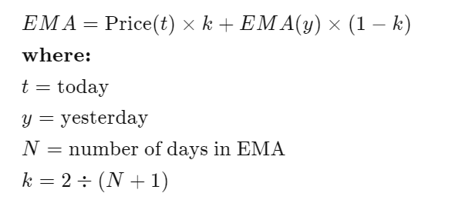
Part 2
Feature engineering
Data transformation using change of frame of reference
Using Exponential Moving average

Slide 7
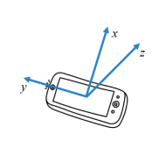
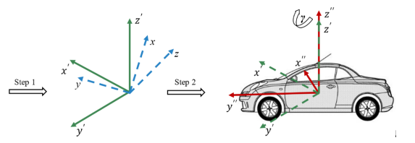
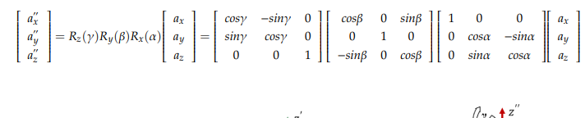
Data transformation (Next Steps)
Changing the frame of reference using gyroscope data
Using yaw, pitch, roll rotation from mobile coordinates to fixed coordinate system

Slide 8
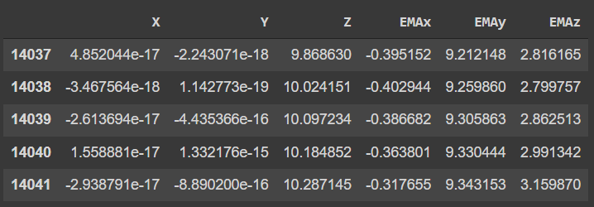
Results after data transformation

Slide 9
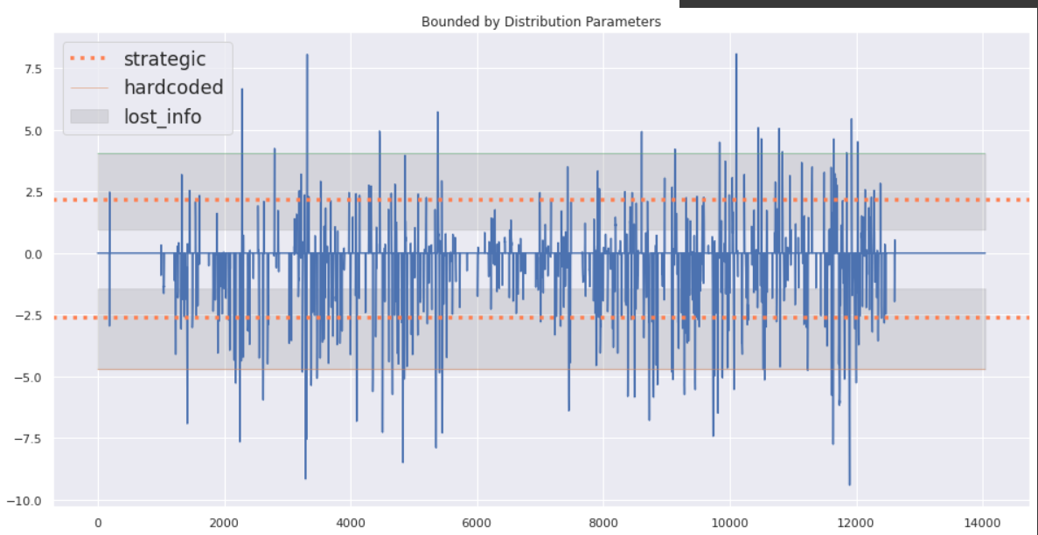
Visualization of EMA of transformed data

Slide 10
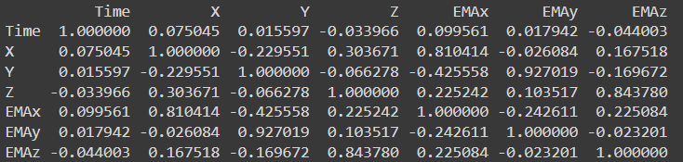
Correlation analysis
From observation, EMAx and x are highly correlated as EMAx is nothing but the function of x
And similarly EMAy and y along with EMAz and z

Slide 11
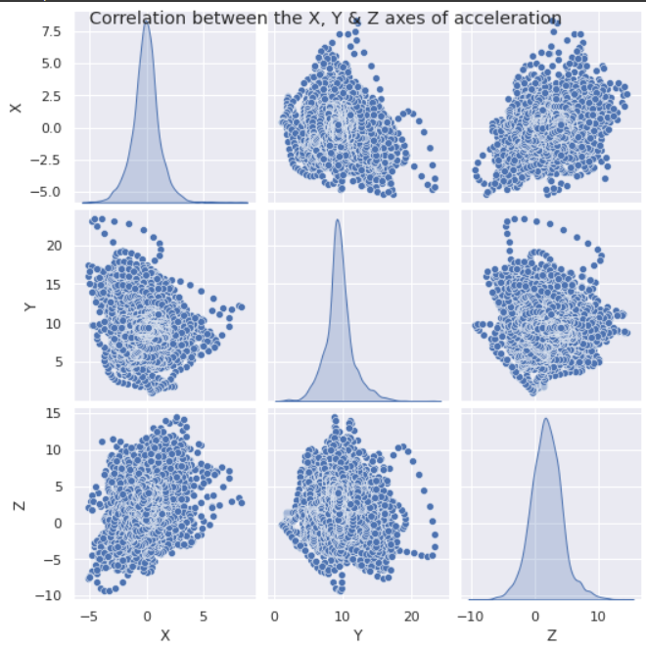
Correlation Analysis
As we can see there is not much correlation between x, y and z and hence they can be used as different feature in the model
But since the thresholding mechanisms used (in the coming slides) are dealing with only one axis at a time, we can not combing them as of now

Slide 12
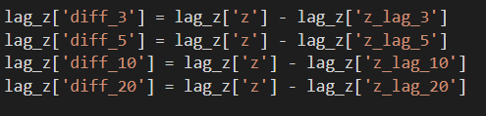
Creating features
Using different lag values to create a delayed version of the signal
And differencing them to use ARIMA model

Slide 13
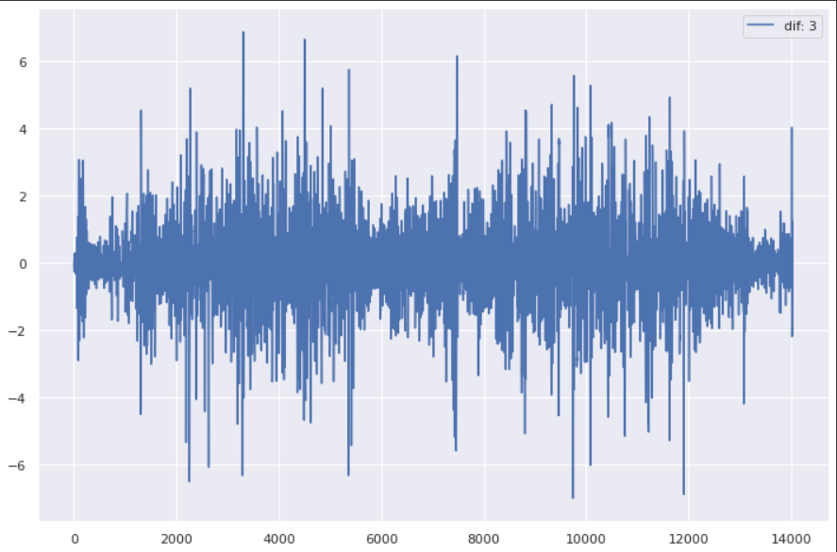
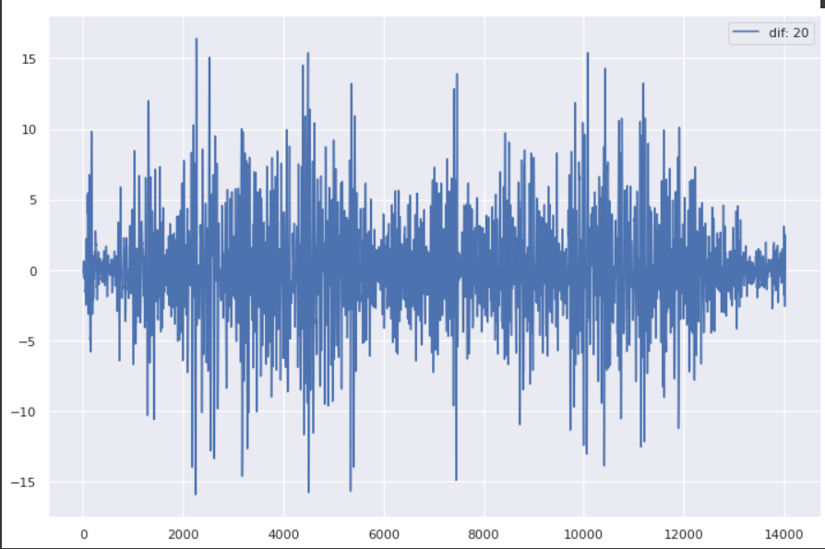

Slide 14
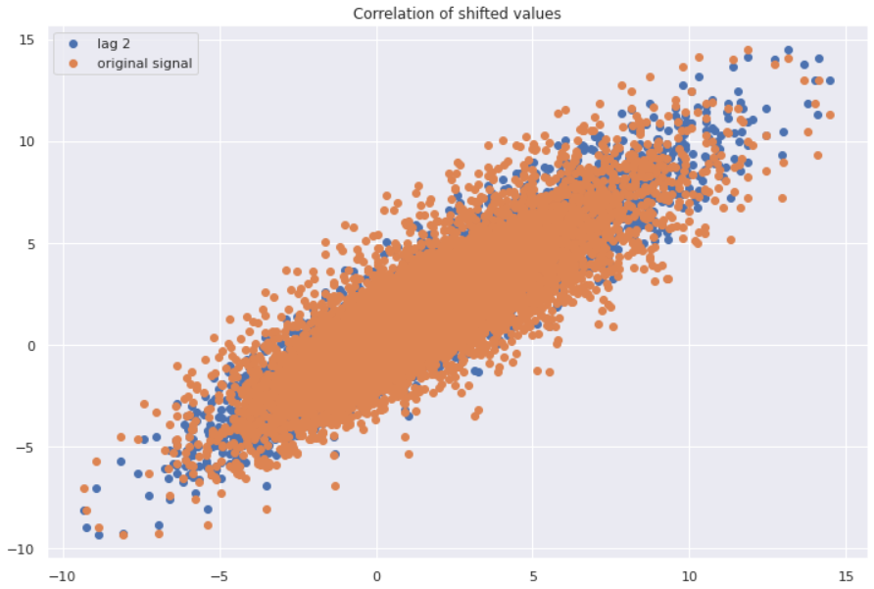
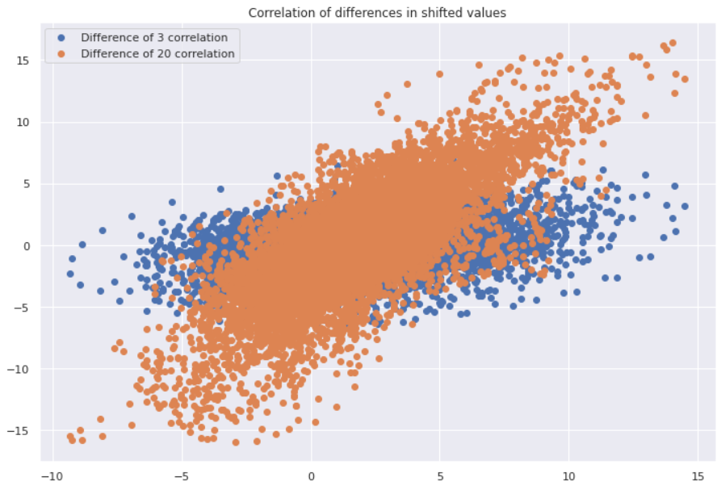
Correlation of generated features
The difference 3 and difference 20 has low correlation with the original z-acceleration then the shifted values. Hence, they'll be more useful.

Slide 15
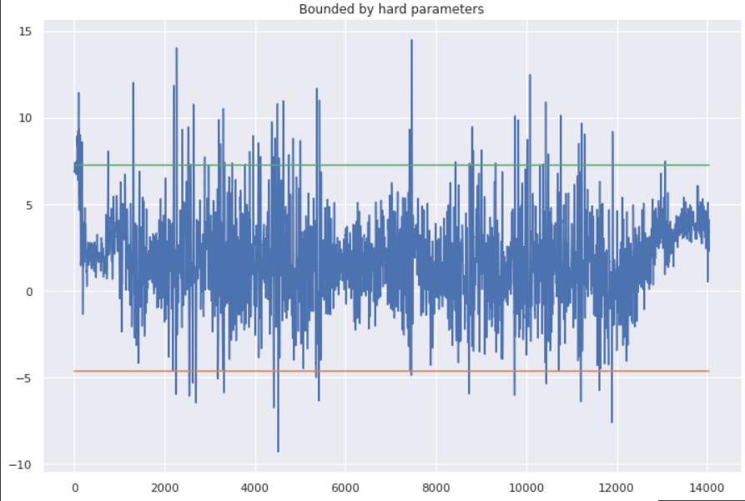
Different Thresholding Mechanism
Z-Threshold
Deals with the EMAz value of the series and checks the following:
1 when EMAz > mean + std : bump
0 when EMAz > mean- std and EMAz < mean +std : plain road
-1 when EMAz < mean -std : pothole
For example:

Slide 16
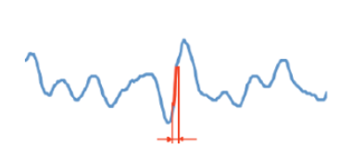
Different Thresholding Mechanism
Z-diff
Deals with the lag values of the z acceleration of the series and checks the following:
1 when lag_0 - lag_1 > mean: bump
0 when lag_0 - lag_1> mean- std and lag_0 - lag_1< mean +std : plain road
-1 when lag_0 - lag_1< mean -std : pothole
For example:

Slide 17
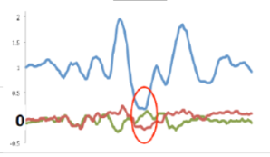
Different Thresholding Mechanism
G-zero
This states that when the body is about to enter or exit a pothole, the body is in the state of freefall which is indicated by all the three acceleration values being almost equal to 0
For example:

Slide 18
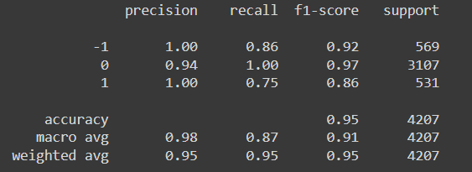
Classification Models
LDA
It works by calculating summary statistics for the input features by class label, such as the mean and standard deviation.
These statistics represent the model learned from the training data.
Maximises the j(w) function which is the ratio of between classes variance and within class variance
The between class variance needs to be maximised and the within class variance should be minimum.
Accuracy with Z- thres: 95%
Accuracy with Z- diff: 97%
Accuracy with G-zero: 96%

Slide 19
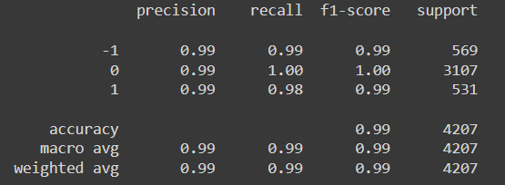
Classification Models
SVM
the kernel SVM projects the non-linearly separable data lower dimensions to linearly separable data in higher dimensions in such a way that data points belonging to different classes are allocated to different dimensions.
Used radial basis function as the kernel as it performs better than linear kernel in this case.
Accuracy with Z- thres: 99%
Accuracy with Z- diff: 98%
Accuracy with G-zero: 97%

Slide 20
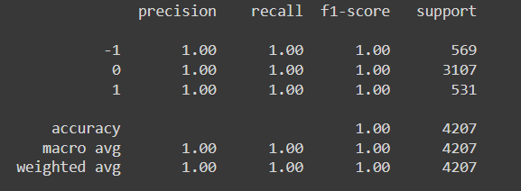
Classification Models
Decision tree
A decision tree is a flowchart-like structure in which each internal node represents a "test" on an attribute, each branch represents the outcome of the test, and each leaf node represents a class label (decision taken after computing all attributes).
Accuracy with Z- thres: 100%
Accuracy with Z- diff: 98%
Accuracy with G-zero: 97%

Slide 21
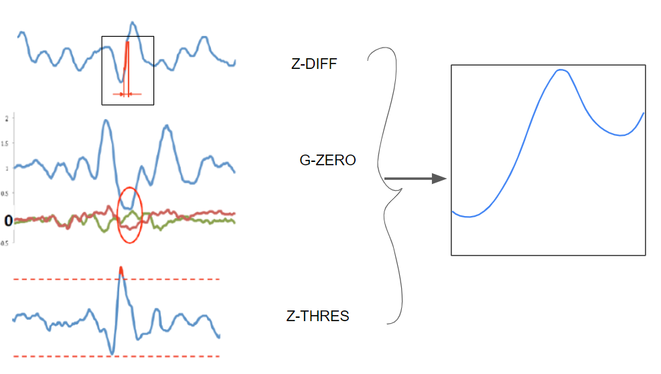
Tile sampling
For identification of cracks

Slide 22
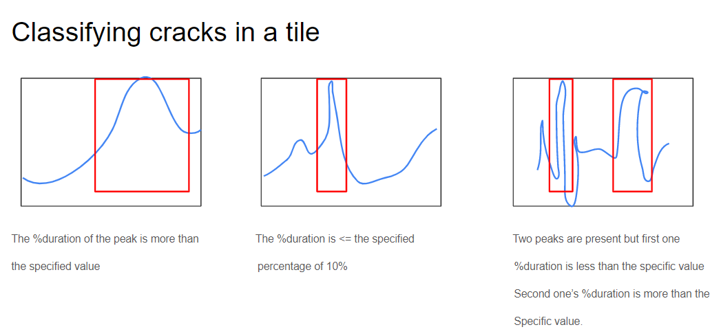

Slide 23
Next Steps….
Mathematical relationship between the three thresholding values
In order to find cracks, tile sampling has to be done.
For a four wheeler, any change in the z axis also causes a sudden change in the x- axis acceleration.
Using unsupervised learning algorithms like KNN, k-means clustering, ,CNN, FNN, etc
Optimization using hyperparameter tuning (grid search)
Plotting the classification data on google earth

Slide 24

Expected Outputs
Locate the roads used in the project on map using gps data
Classification of different types of anomalies in the road
Optimization of the result
Prediction of anomalies

Slide 25
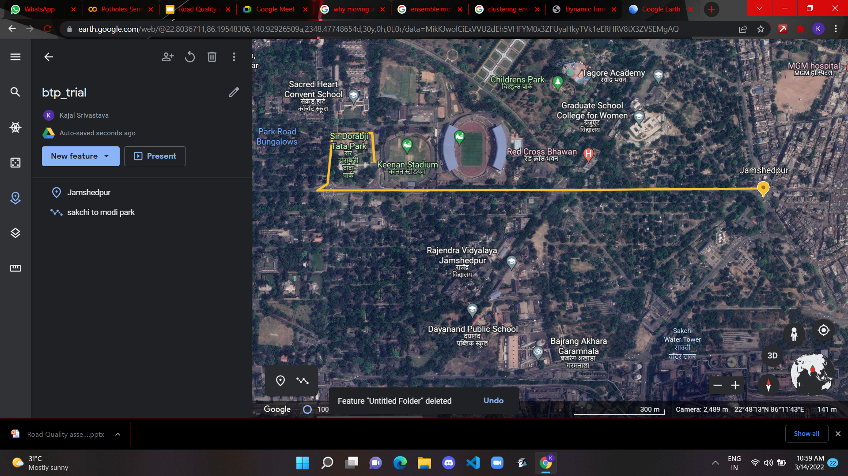

Slide 26
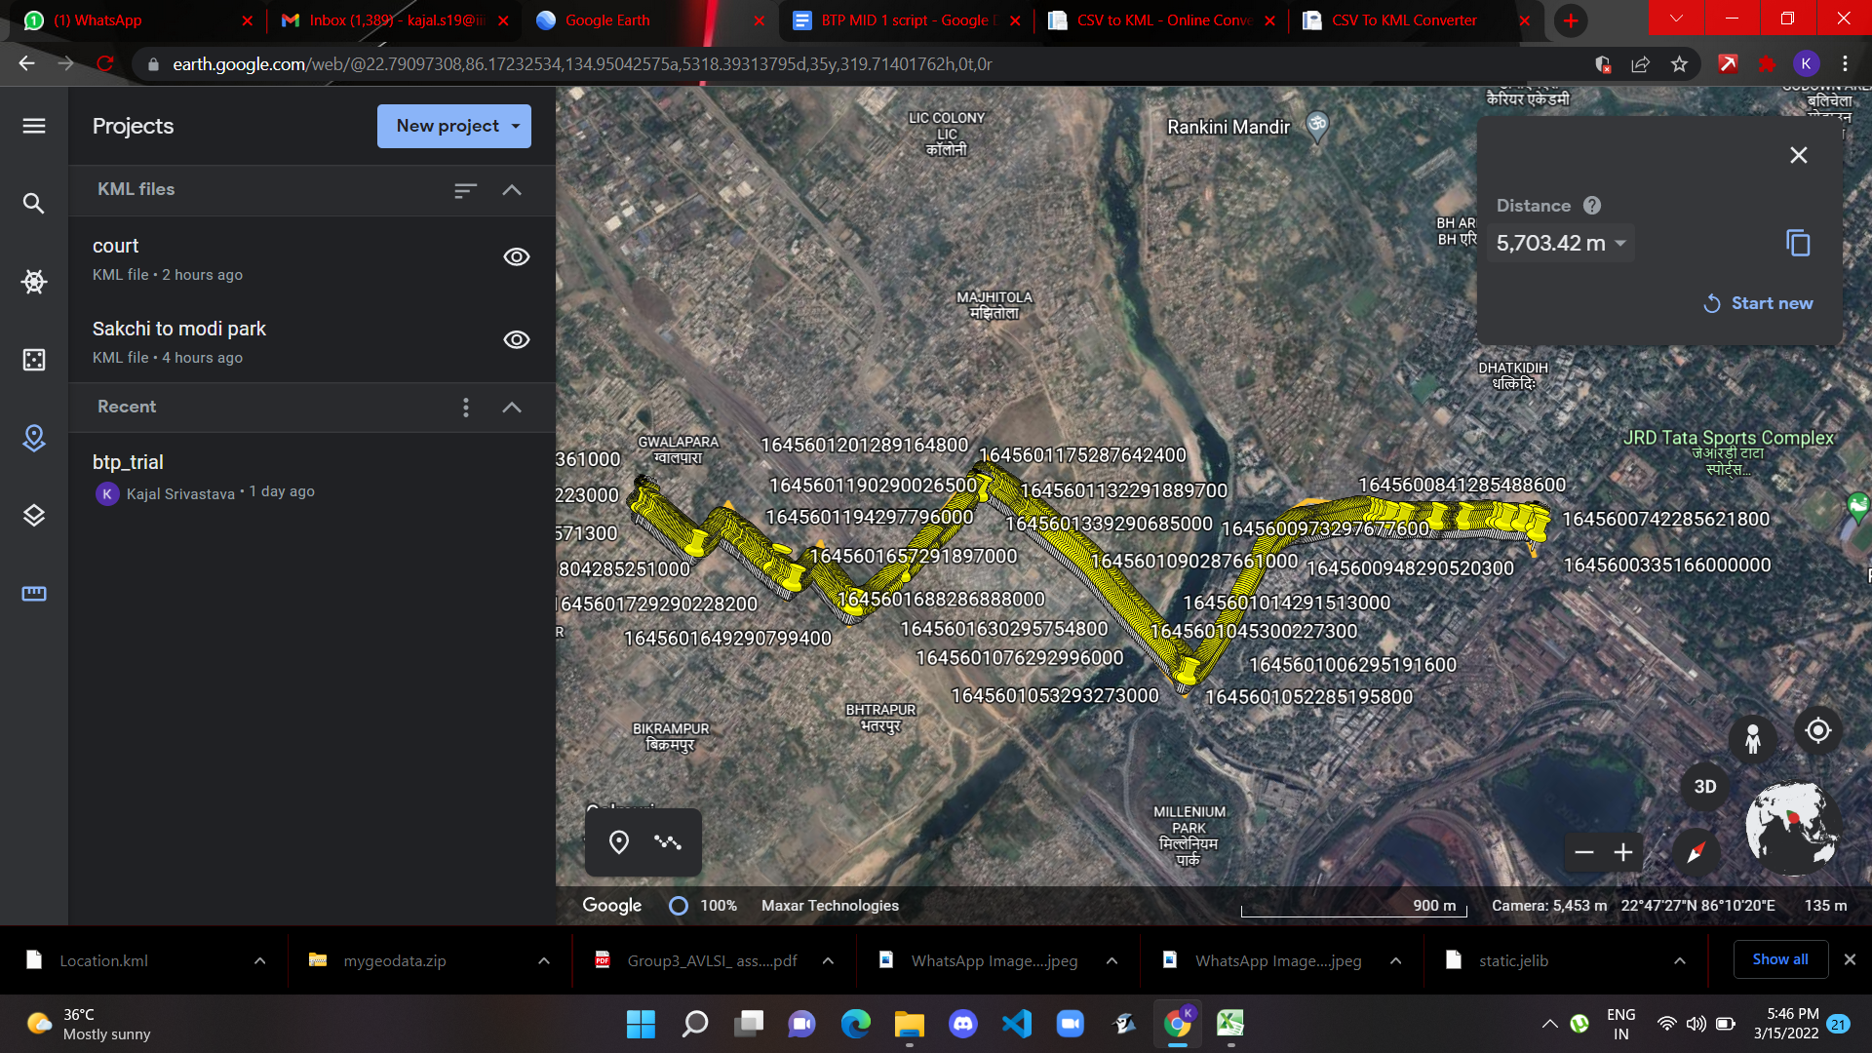

Slide 27





Tech stacks used:

Slide 28
References
Sabir, N.; Memon, A.A.; Shaikh, F.K. Threshold based efficient road monitoring system using crowdsourcing approach. Wirel. Pers. Commun. 2019, 106, 2407–2425. Here
Sattar, S.; Li, S.; Chapman, M. Road surface monitoring using smartphone sensors: A review. Sensors 2018, 18, 3845 here
Singh, G.; Bansal, D.; Sofat, S.; Aggarwal, N. Smart patrolling: An efficient road surface monitoring using smartphone sensors and crowdsourcing. Pervasive Mob. Comput. 2017, 40, 71–88. Here
All images are taken from here

Slide 29
Thank You!
Drive, don't fly

